Slide 1
B18 Probton
Review Date:
July 4, 2024 Review Version:
Schematic Review Video (not updated): https://youtu.be/nWU8KJn_Hf8
ASIC Solution for Optical Probe Station
Discord name | Affiliation | Experience | Role
timlam0531 | HKUST, Hong Kong | Hobbyist | Team lead
abraaaar | Toronto Metropolitan University, Toronto | Undergraduate student | Team member
belkacem | University of Tlemcen, Algeria | PhD | Team member
nitin_i | University of California, Santa Barbara | AMS Design Engineer | Team member
rezasetiabekti8375 | University College Dublin, Ireland | Master student | Team member
ashmita1509 | University College Dublin, Ireland | Master student | Team member
vik_lyn_ | University of Waterloo | Undergraduate student | Team member
anna_b75_06065 | None | Hobbyist | Team member
CadMiuM#9906 | HKUST, Hong Kong | Undergraduate student | Team member
Looking for members |  |  | Mixed Signal

Slide 2
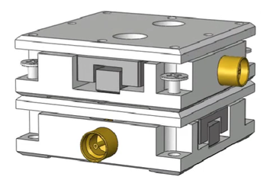
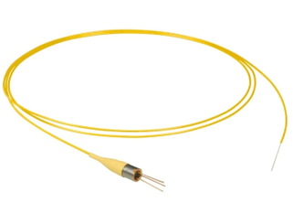
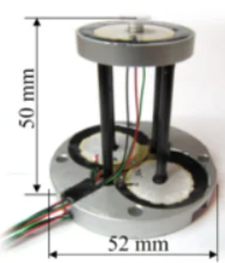
Design Objective:
Intended use:
Deliver low-latency direction indicators and signal intensity data to drive motorized alignment hardware.
Extract alignment direction using voting filter while automatically isolating and discarding corrupt signal data.
MEMS
Actuator [2]
XY-Stage [1]
Photodetector
Thorlabs FDSP625 Pigtailed Si Photodiode
Buzzer-Scanner (Wang et al. 2013)
Photodetector
Thorlabs FDSP625 Pigtailed Si Photodiode
Link: https://doi.org/10.1016/j.ohx.2022.e00317
Key Specifications:
Sensitivity: 25.0 nm/V
Resolution:
Backlash: 160 – 195 nm
Step error: ~ 7%
Link: https://www.thorlabs.com/thorproduct.cfm?partnumber=FDSP625
Key Specifications:
Spectral Band: 320 nm to 1000 nm
Response Speed: 700 ps rise/fall time
Noise: 0.01 nA dark current
Link:
https://doi.org/10.1088/0957-4484/24/45/455503
Key Specifications:
XY Range: 5 µm
Nonlinearity: 2.11% X / 2.73% Y
Noise / Resolution: ~0.06 nm
Resonance: ~360 Hz (X/Y)

Slide 3
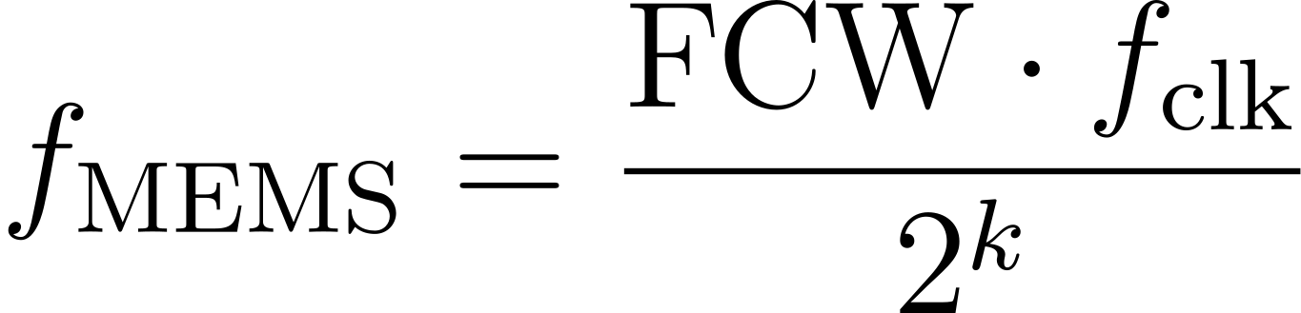
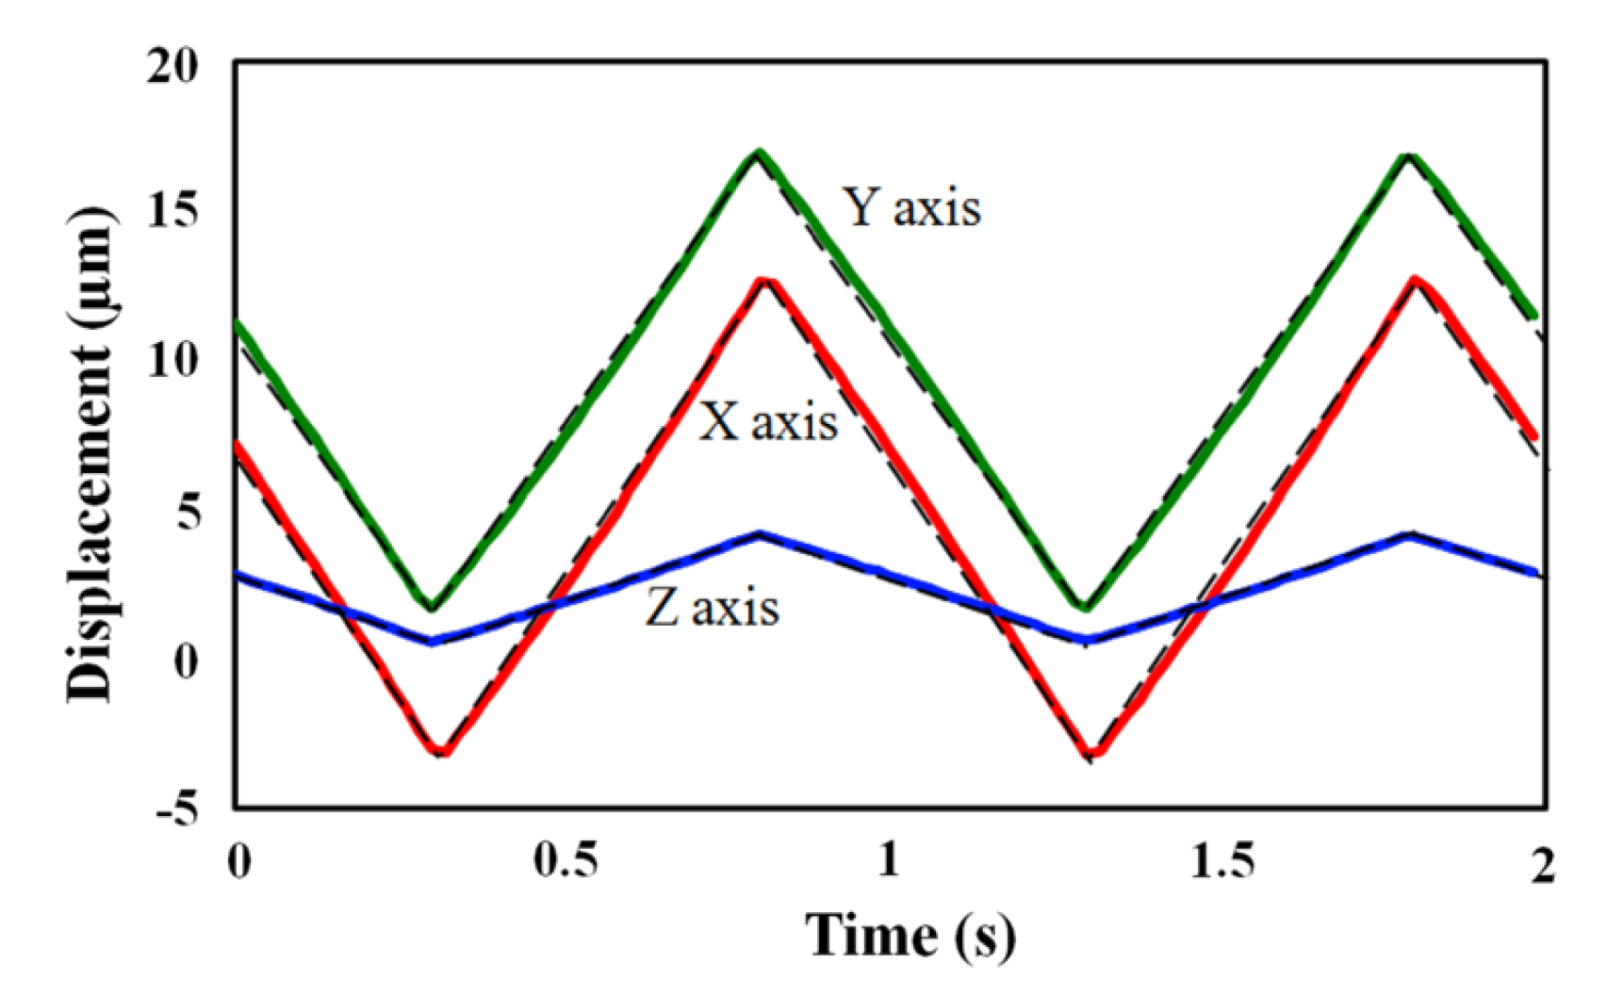
Design Specification
5MHz clock speed
Raw readout: 700ps rise fall time, 1 μA - 40 μA, 3.5pF
Allowed MEMS frequency : 2.38 Hz ~ 156.24761 kHz 16 bit Frequency Control Word 21 bit Phase Accumulator
Low Frequency Filter ~160 kHz
Mems_drv compatible to control External MEMS DAC Driver (±10V Triangular Wave)
Wave mixer and comparator able to operate at 1.65V midrail to isolate sign of dc_offset for directional identification
System is able to identify real signal from noise and jittering is minimize during idle and calibration

Slide 4
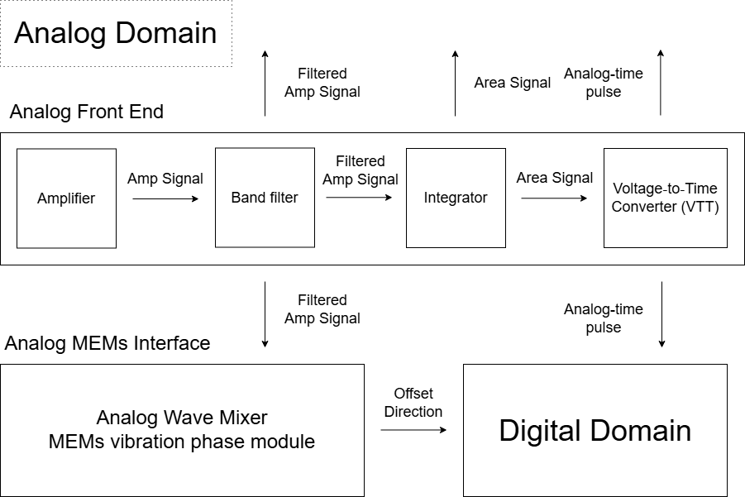
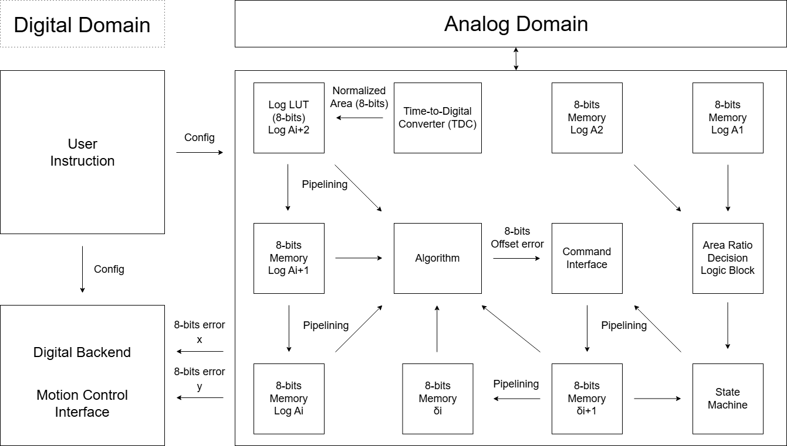

Decision - Simplify and Reduce to core function
Based on Proposal Review Feedback
Skip unnecessary signal processing component that enhance accuracy of prediction Removed: Integrator, Voltage to Time Converter, Time to Digital Converter
Report Wave Mixer Error as raw analog output for user reading
Remove XY Motion Control Interface
Extract and report low latency direction information as compass to alignment center based on dither motion
Simplify Digital Signal Processing to simple voting filter to discard false signal and remove 3-point Gaussian Area Algorithm

Slide 5
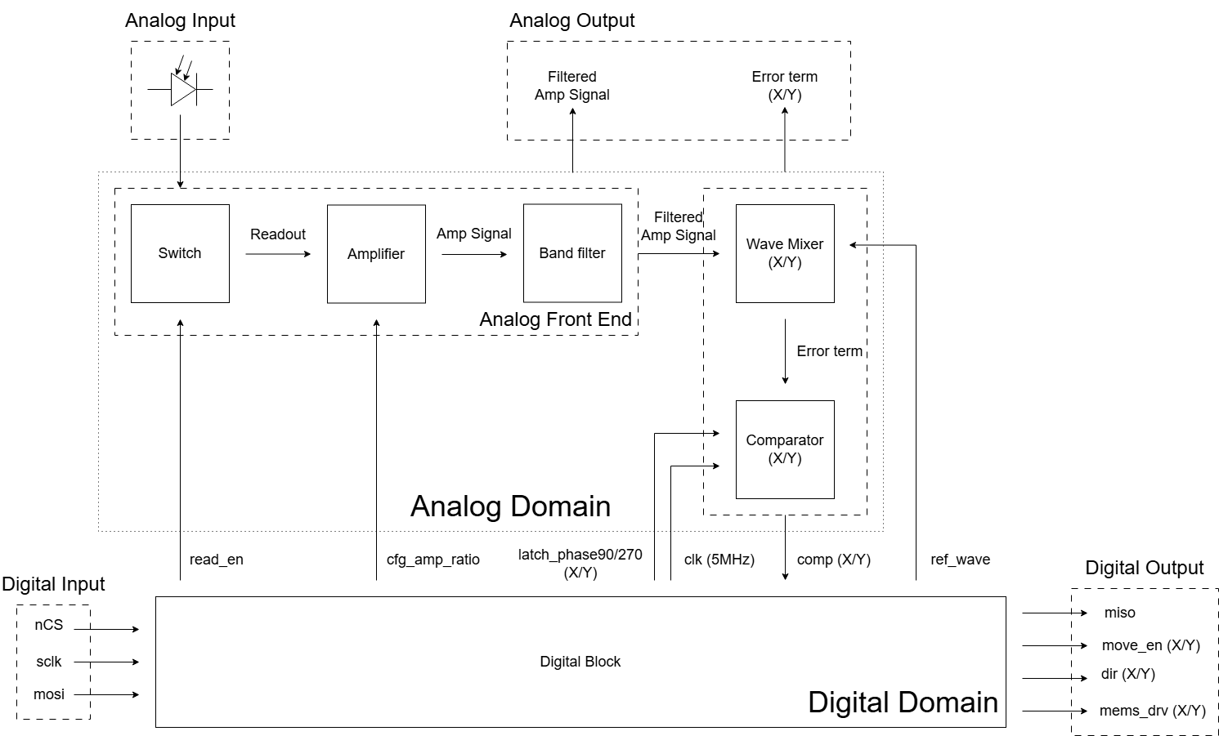
System Overview - Block Diagram and Pin count
State Control Mixed Signal System Pin count (14) Analog pin for readout (4) SPI (4) Custom Config, User Command, Status Report Low latency feedback (4) move_en dir ΔΣ Modulated Digital Wave (2) mems_drv

Slide 6
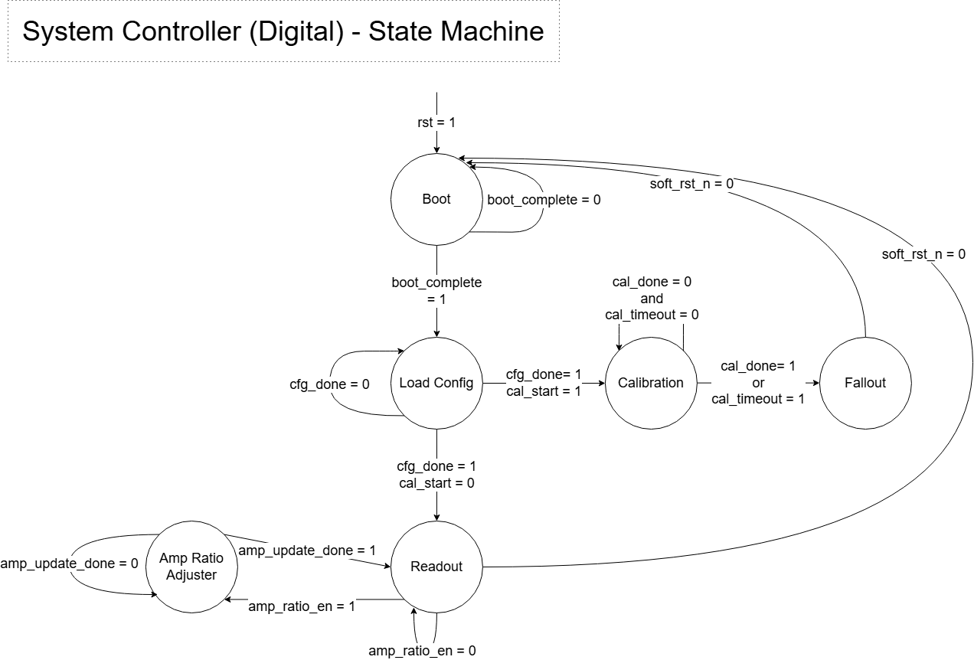
System Overview - State Machine
Boot
Load Config
Calibration (Optional)
Fallout (Optional)
Readout
Change Amp Ratio
After Load Config Split to 1. Calibration (missing phase_offset from SPI import) Enter Fallout after calibration Reboot system and load phase_offset data
2. Readout

Slide 7
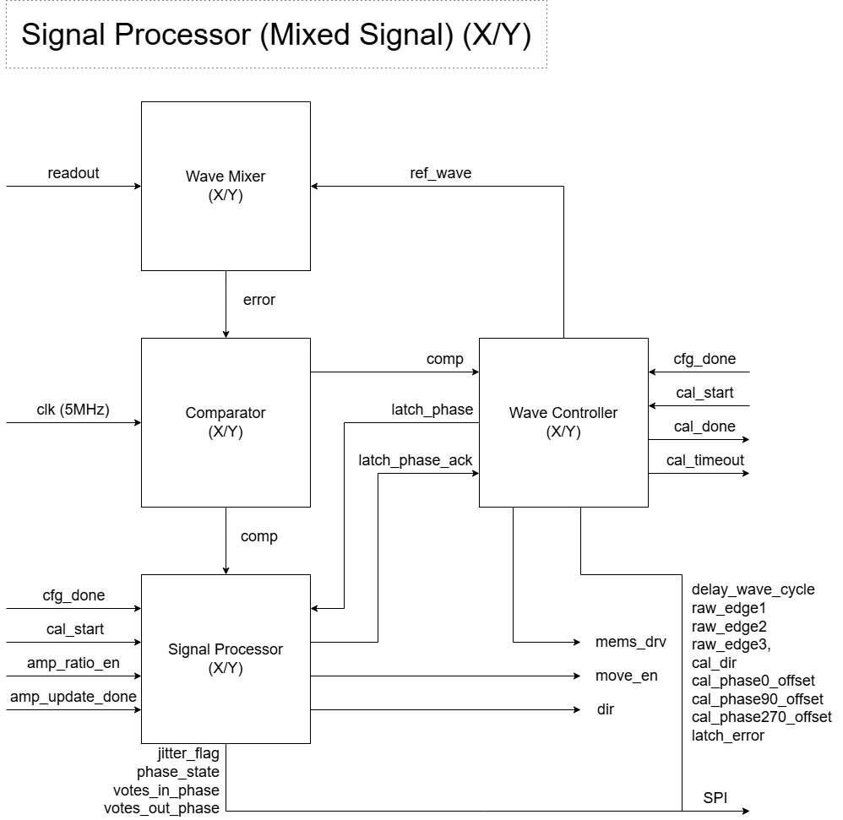
System Overview - RTL Traffic
Readout
Dynamic Comparator
Wave controller 1. Wave generation (Driver/Reference Wave) - Sigma Delta Modulated 2. Calibration (Optional) 3. Latch pulse (90°/270°)
Signal processor Output move_en, dir
Intermediate RTL for SPI and handshake High: 3.3V Low: 0V Minimize Digital-Analog Crossing to avoid switching noise and complexity

Slide 8
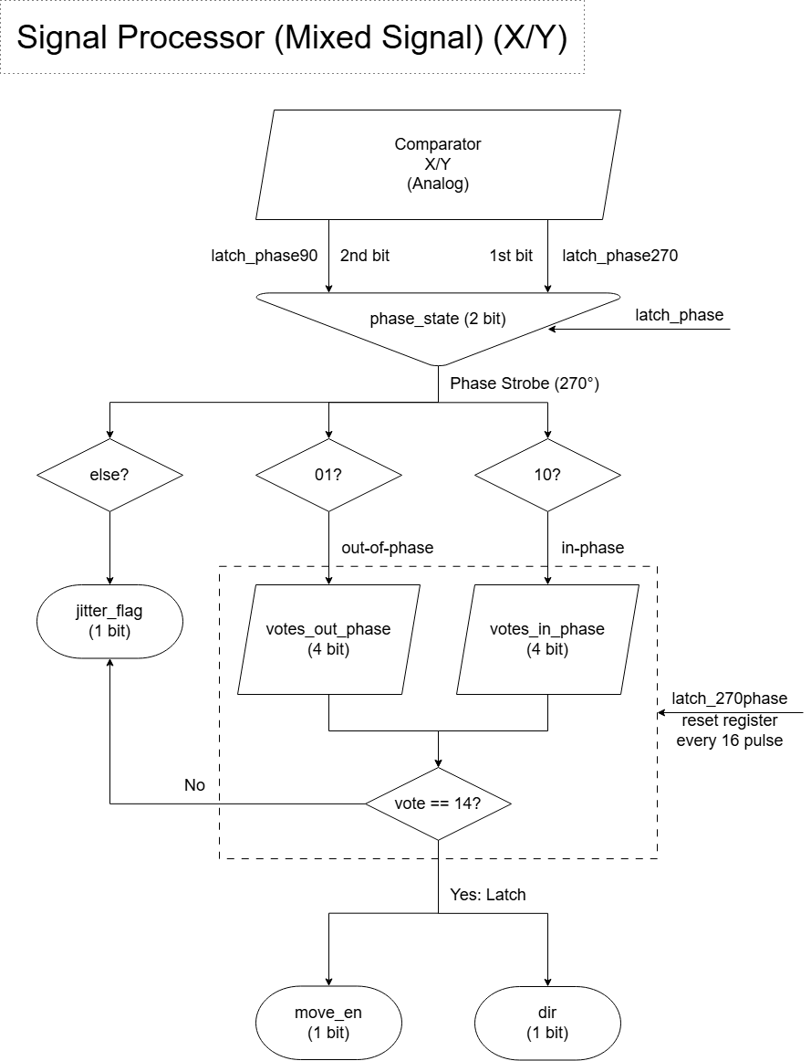
System Overview - Signal Processor
Comparator set to baseline 1.65V midrail as dc_offset = 0 from wave mixer error output.
Comparator goes through rs latch and inverter to store its value, ready for digital domain to retrieve.
Data is accessed and latch every 90°/270° calibrated phase delay.
Data is filtered through 16 sample voting to reject noise and jitter, latch for low latency output
In-phase: High on 0° - 180°, Low on 180° - 360°
Out-of-phase: Low on 0° - 180°, High on 180° - 360° 90° and 270° are the most stable point for latching and parsing comparator output

Slide 9
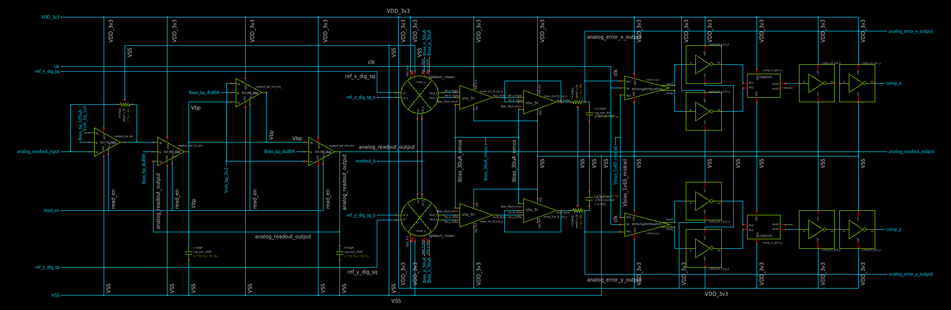
RTL Traffic - Analog Domain
1. Readout
(180μm x 100μm)
2. Wave Mixer (X/Y)
(39.30μm x 55.99μm)
3. Comparator (X/Y)
(67.39μm x 53.38μm)

Slide 10
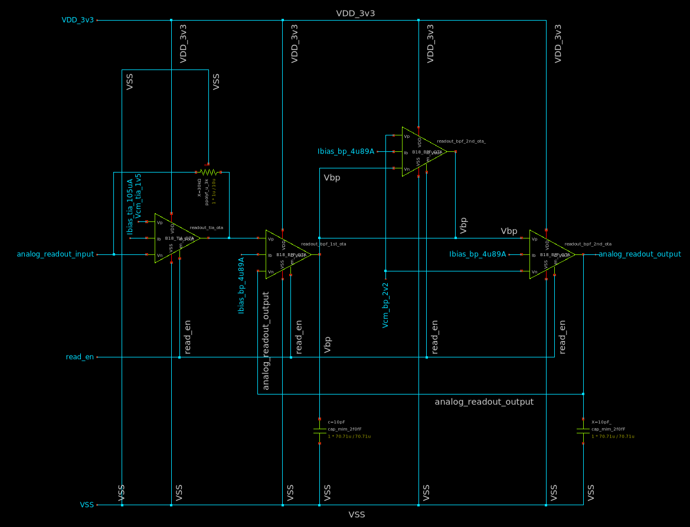
RTL Traffic - Analog Front End
Schematic Completed
Layout still WiP
Reserved Area
(180μm x 100μm)
Readout input (South Center)
Transimpedance Amplifier
Band Pass Filter
Readout output (South Center)
Split to Wave Mixer (X/Y)
In symmetry

Slide 11
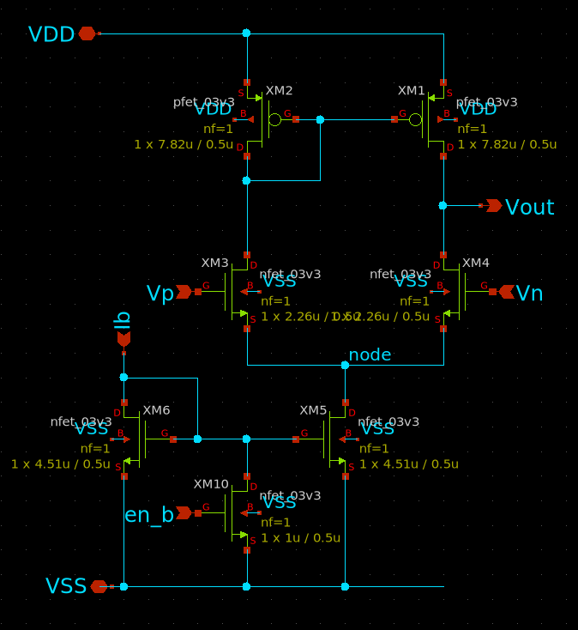
Analog Front End - Transimpedance Amplifier
Active Low Enable signal disables current mirror and rest of amplifier, to be controlled by digital signal until config is complete,

Slide 12
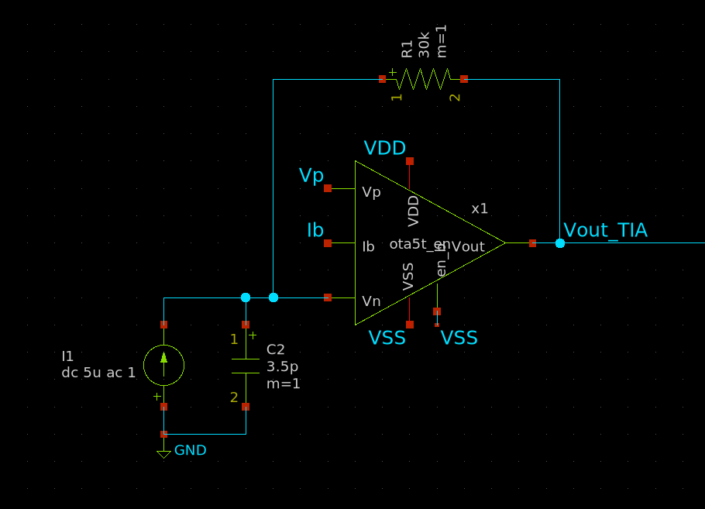
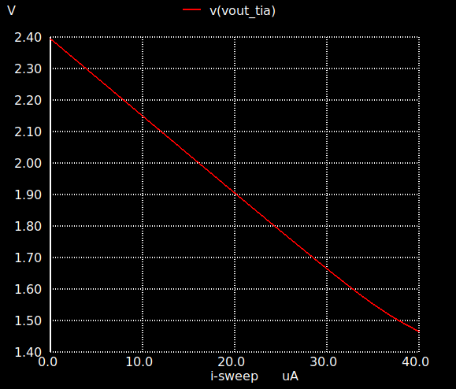
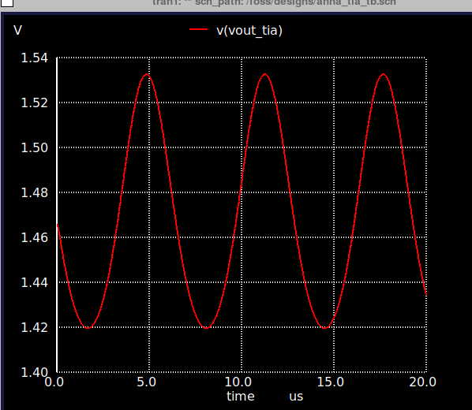
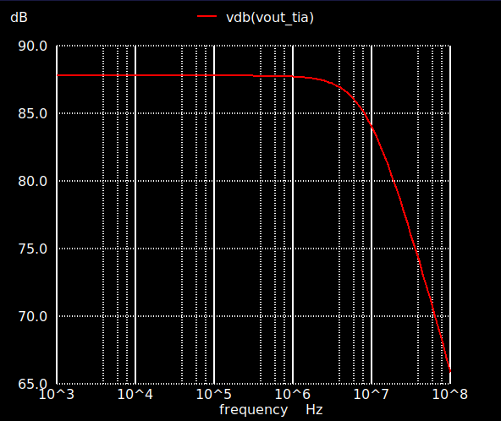
Analog Front End - Transimpedance Amplifier
DC photodetector current sweep
1uA-40uA linear response
Gain
Transient Simulation @156kHz
I_{IN}: 40uA DC, 4uA amplitude
V_{OUT} = 1.47V DC, 0.11V Vpp
Open Loop 1 Hz ~ 10MHz Well covering target specs

Slide 13
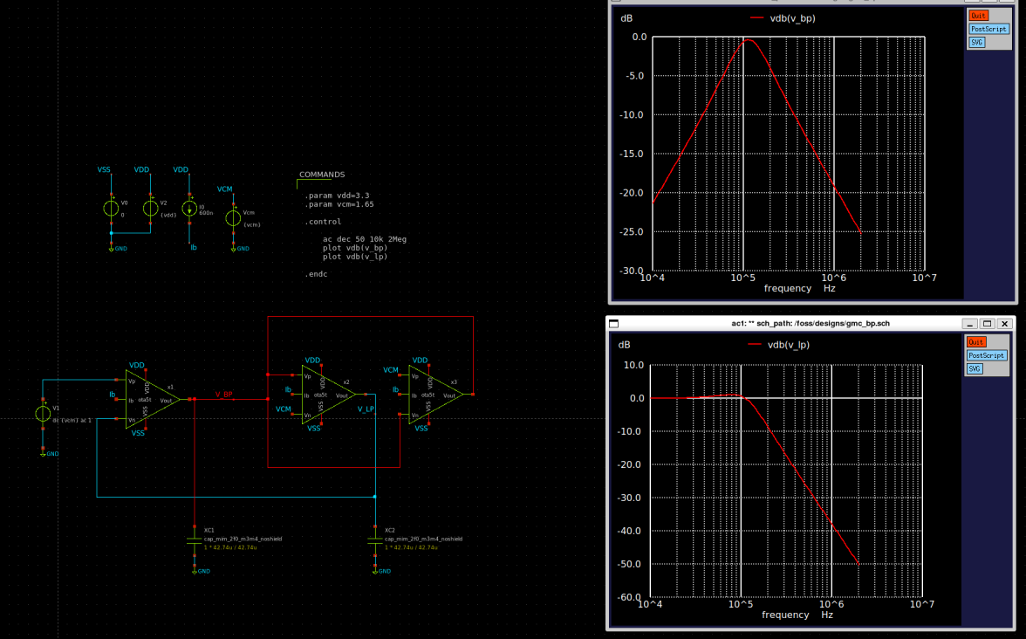
Analog Front End - Two Integrator Loop G_{m}-C BP + LP Filter
Designed for 156 kHz Tunable for each allowed MEMS frequency 2 Hz ~ 156kHz

Slide 14
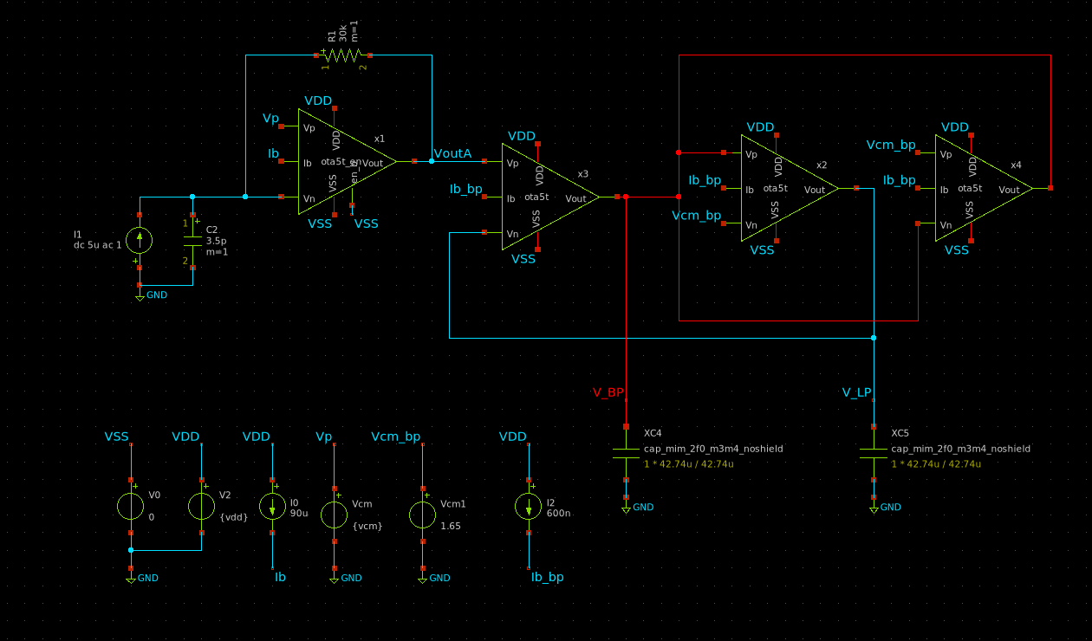
Analog Front End - Testbench of TIA + Bandpass Filter

Slide 15
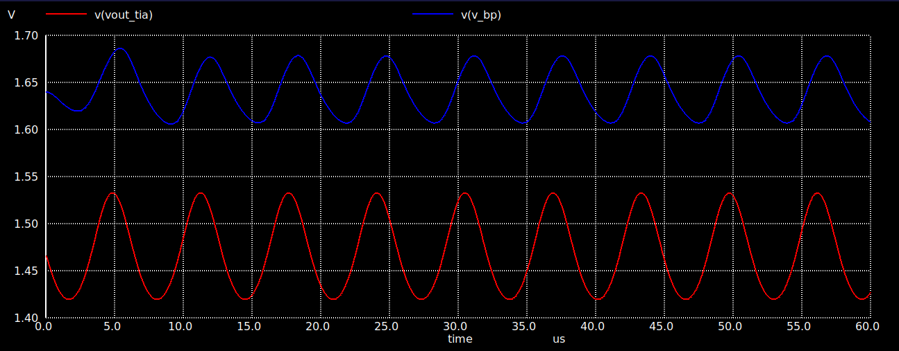
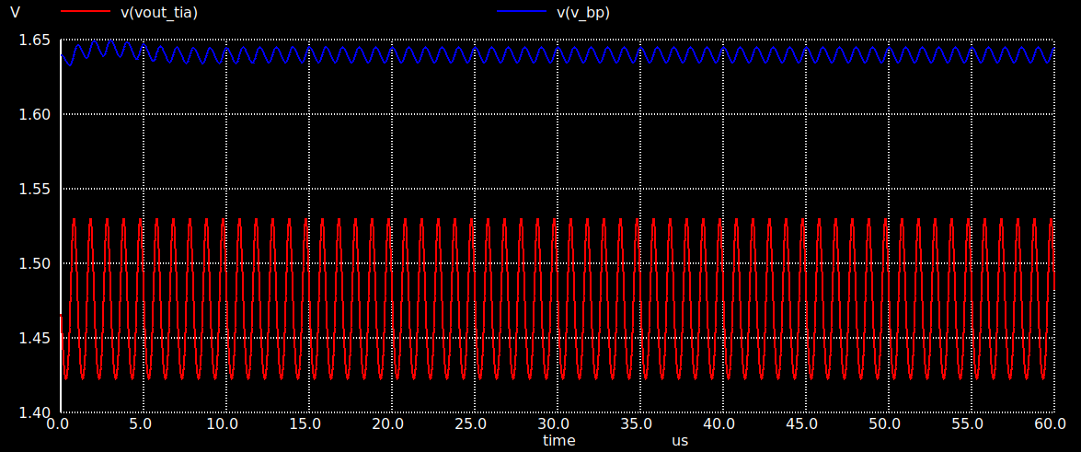
Analog Front End -
TIA + Bandpass
Testbench
Photodetector Sample Input:
40uA DC
4u amplitude
156kHz frequency vs 1MHz shows filtering, though output swing could be improved

Slide 16
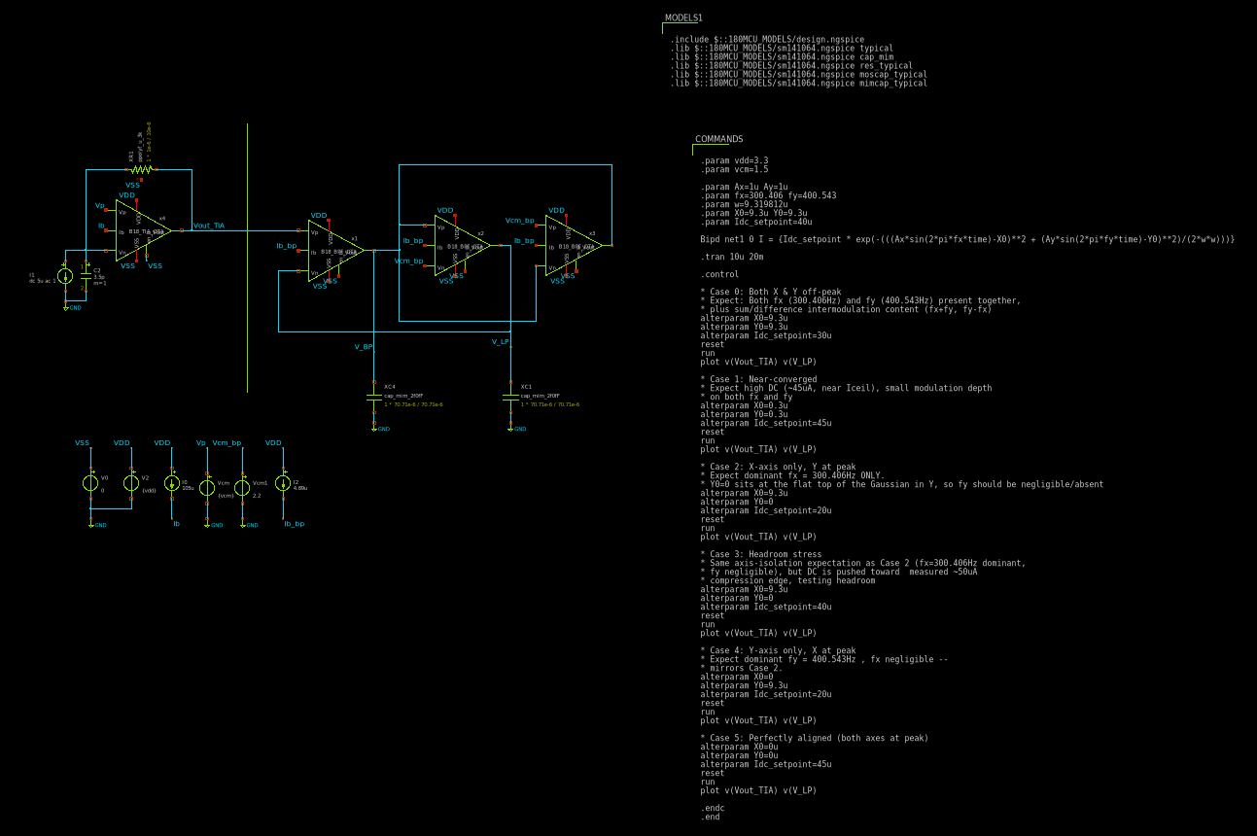
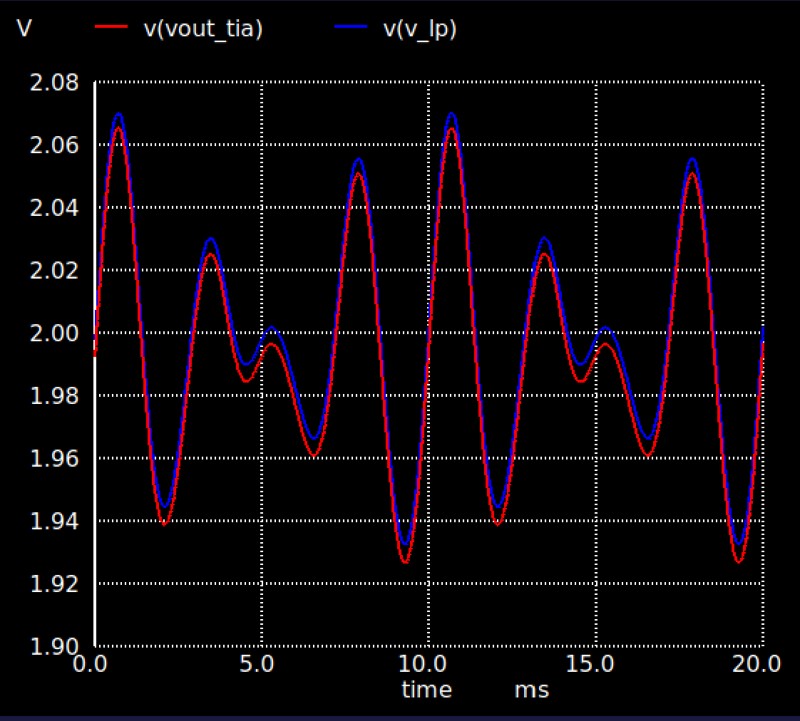
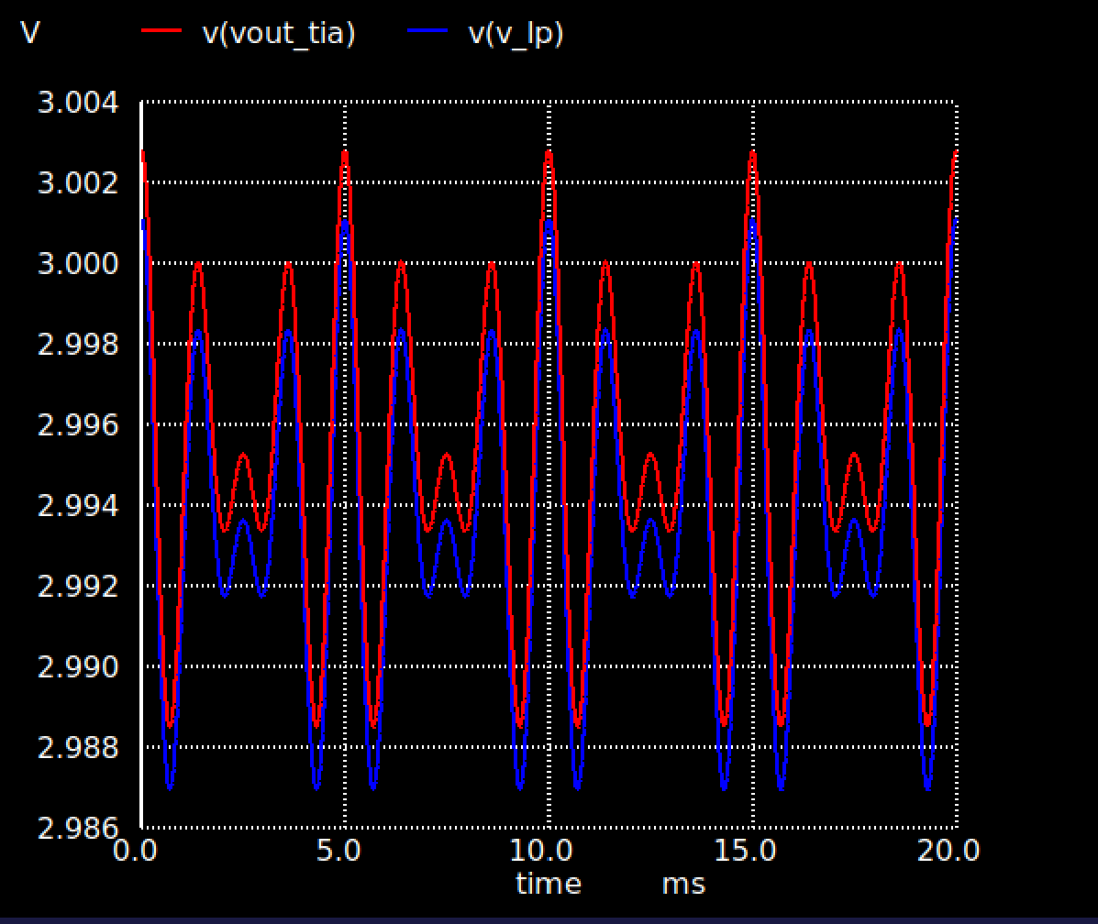
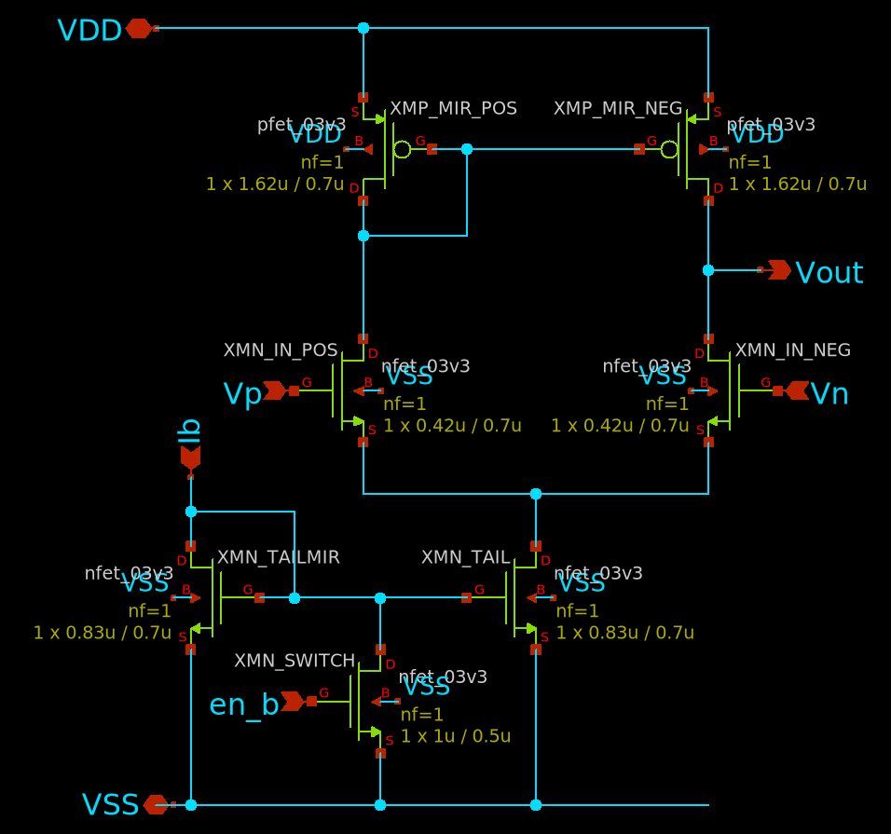
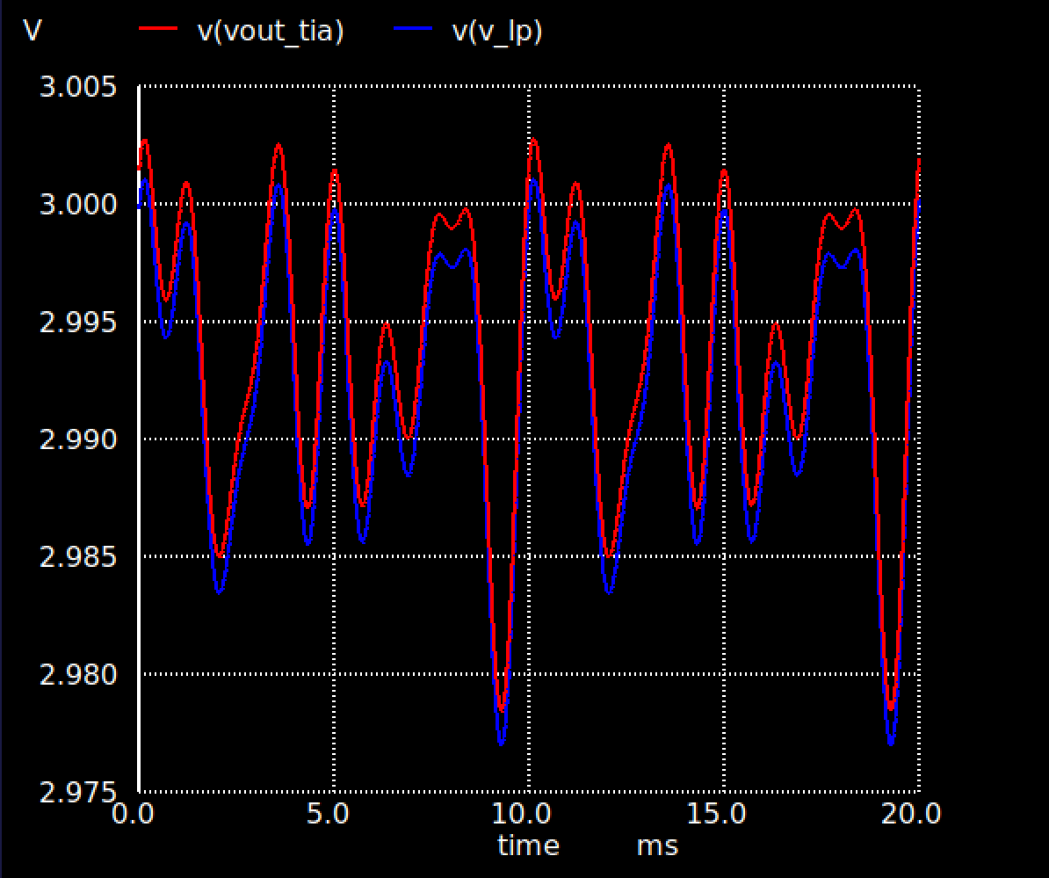
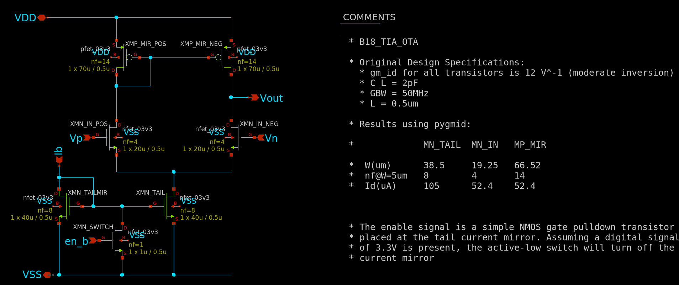
Readout Oscillation
X: 300Hz Y: 400Hz
Analog Front End - Full Simulation
TIA
Band Pass Filter
Band Pass Filter

Slide 17
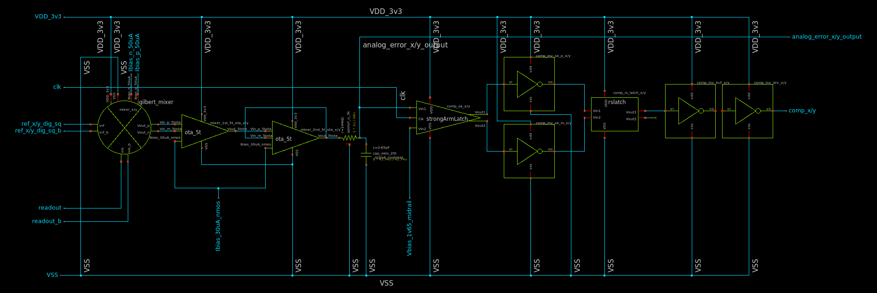
RTL Traffic - Wave Mixer & Comparator
Gilbert Cell → 2x 5T OTA → RC Filter → StrongArm Comparator → Inverter x2 → RS Latch → 2x Inverter

Slide 18
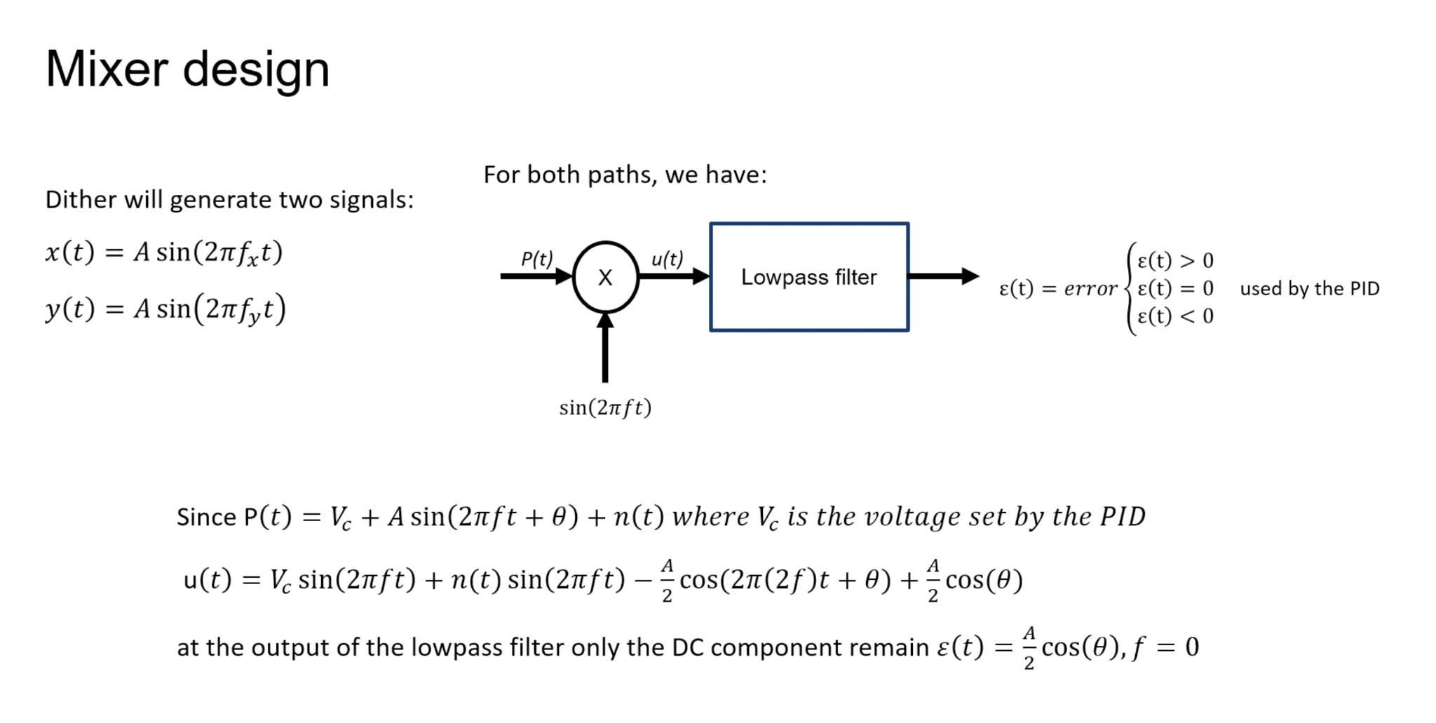

Slide 19
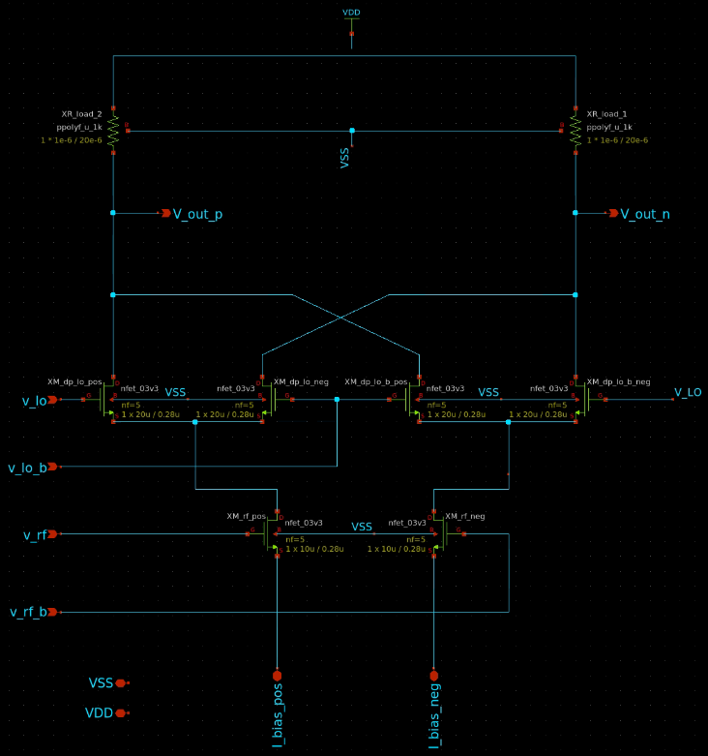
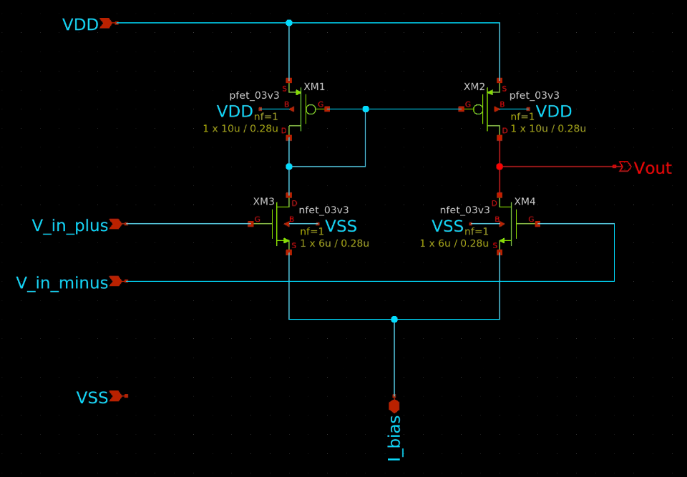
Mixer Schematic
Standard gilbert cell mixer to the left and 5t ota to the bottom
5t ota buffer is needed to convert to single ended and add some gain
5t OTA, current mirror attached to i_bias

Slide 20
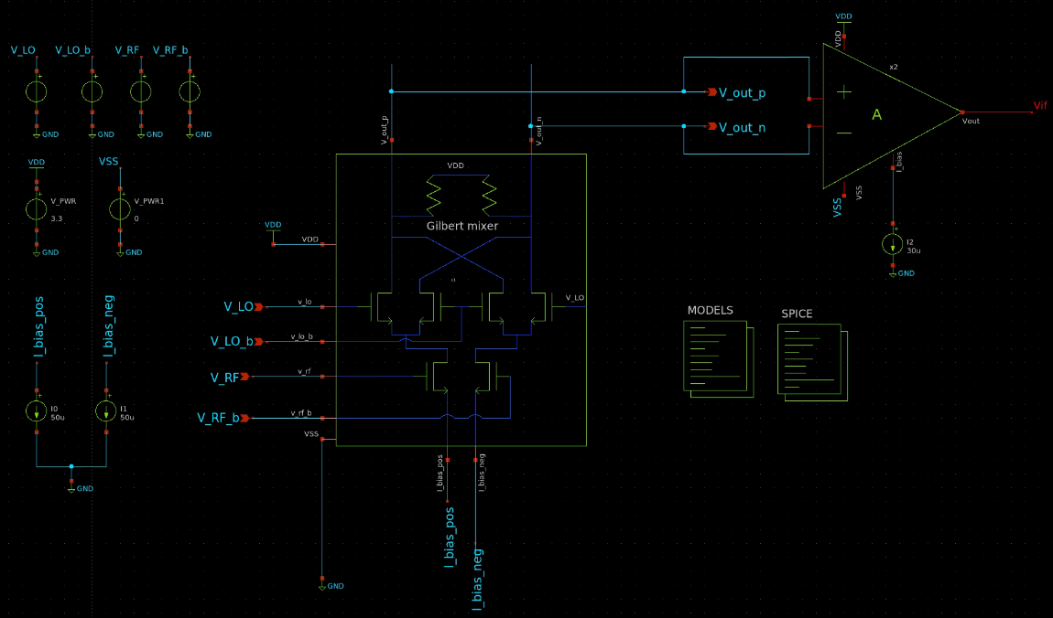
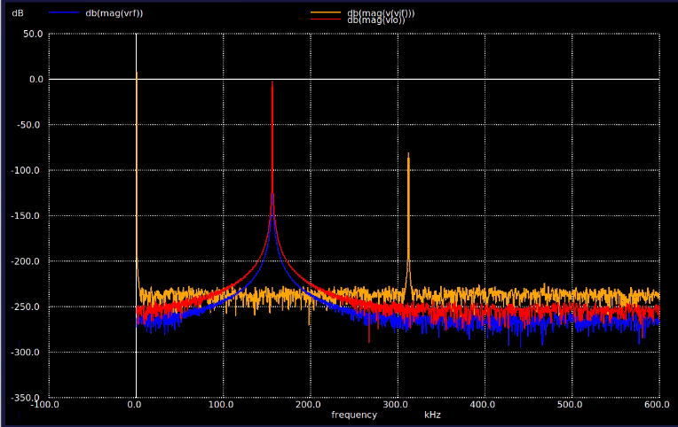
Mixer Testbench
Resulting DC Output to Comparator for algorithm
DC
156kHz
312kHz

Slide 21
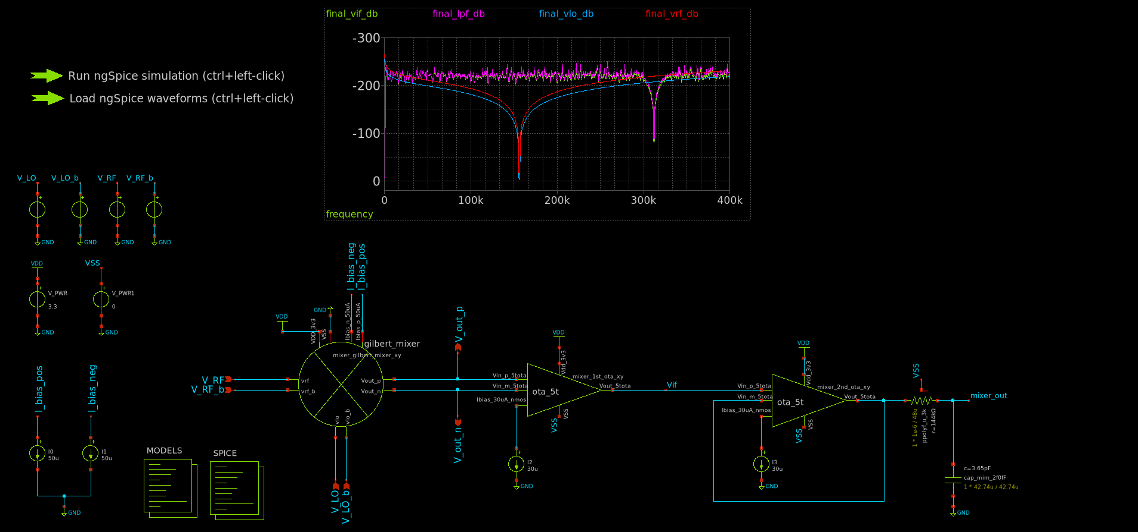
Mixer Testbench with low pass filter (fc = 302.80kHz)

Slide 22
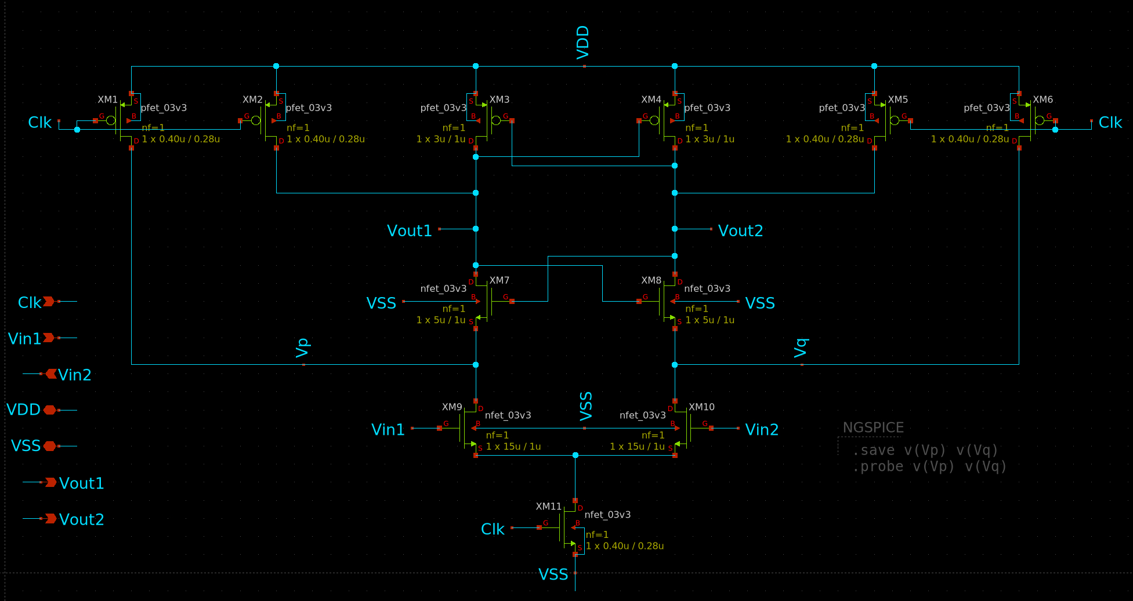
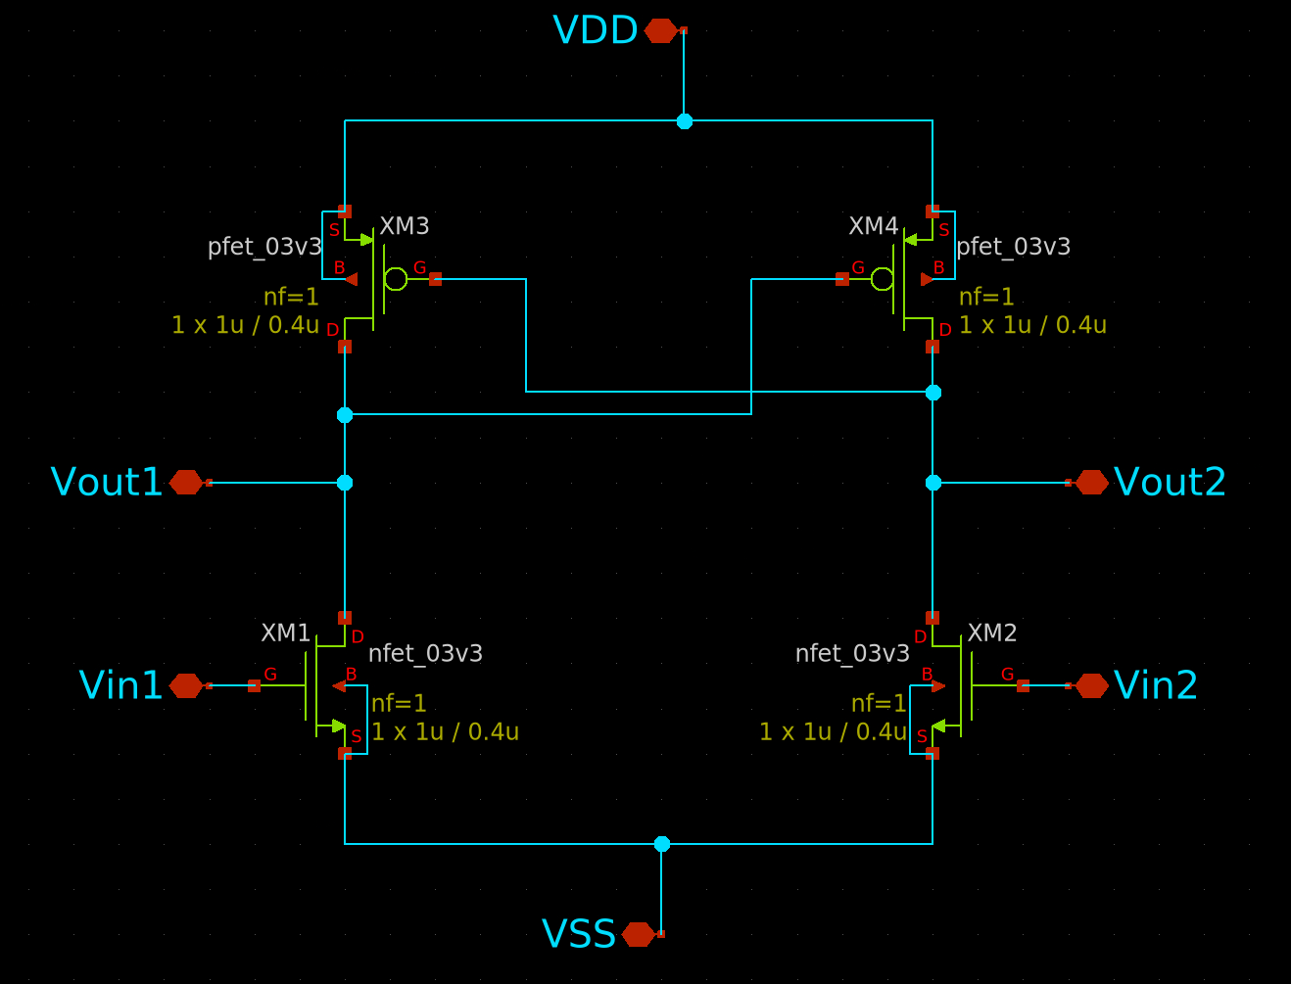
Comparator Schematic
Simple Strong Arm Latch Comparator
Simple RS Latch for memory

Slide 23
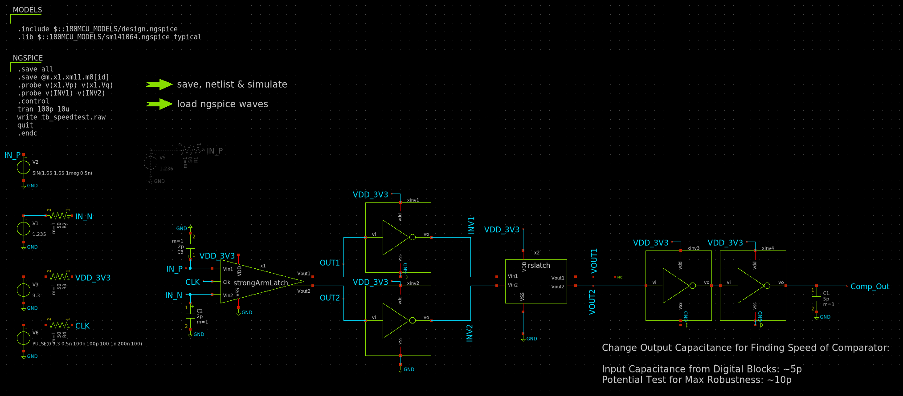
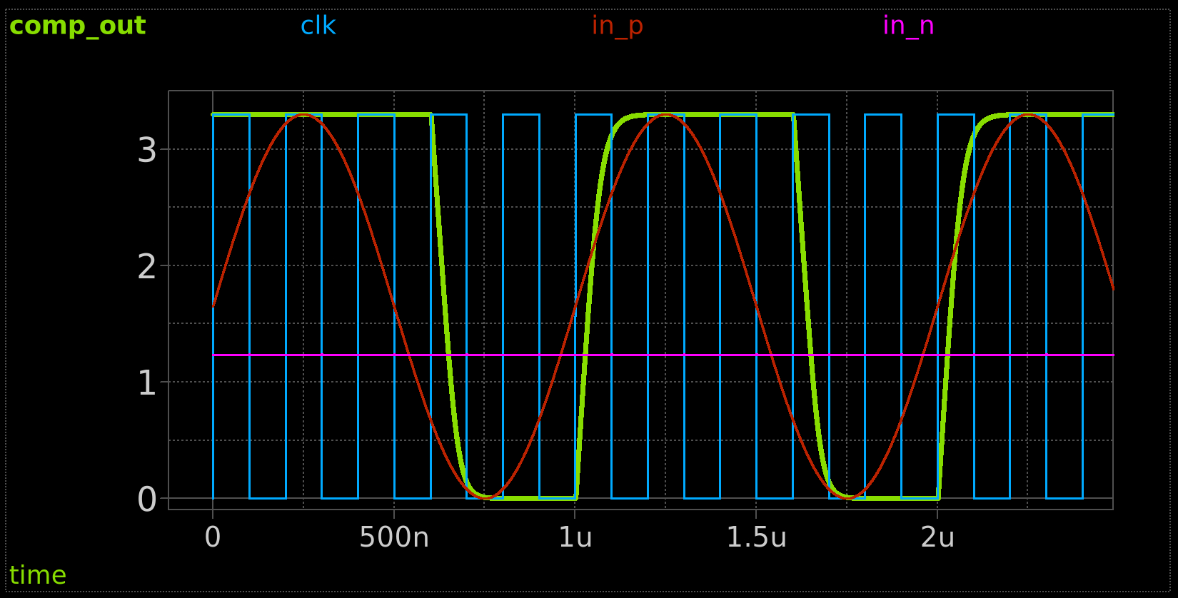
Comparator Testbench
In_p: wave mixer output In_n: dc offset (V mid rail) Comp_out: digital interface

Slide 24
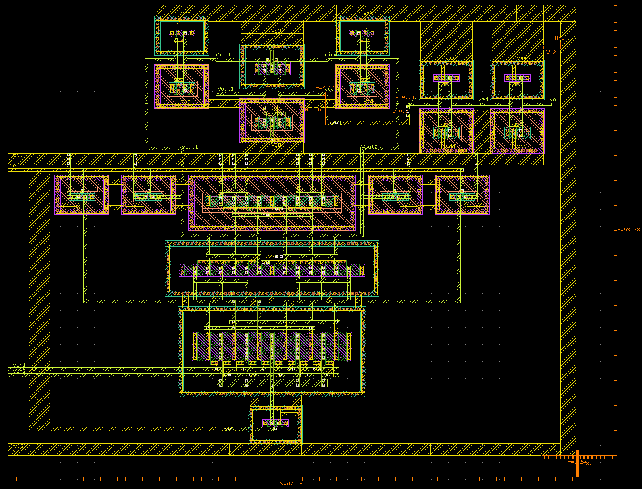
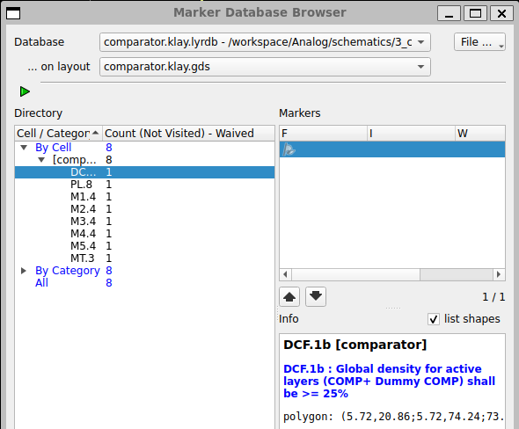
Comparator Layout DRC
Can ignore density rules for all metals and poly and active layers for DRC

Slide 25
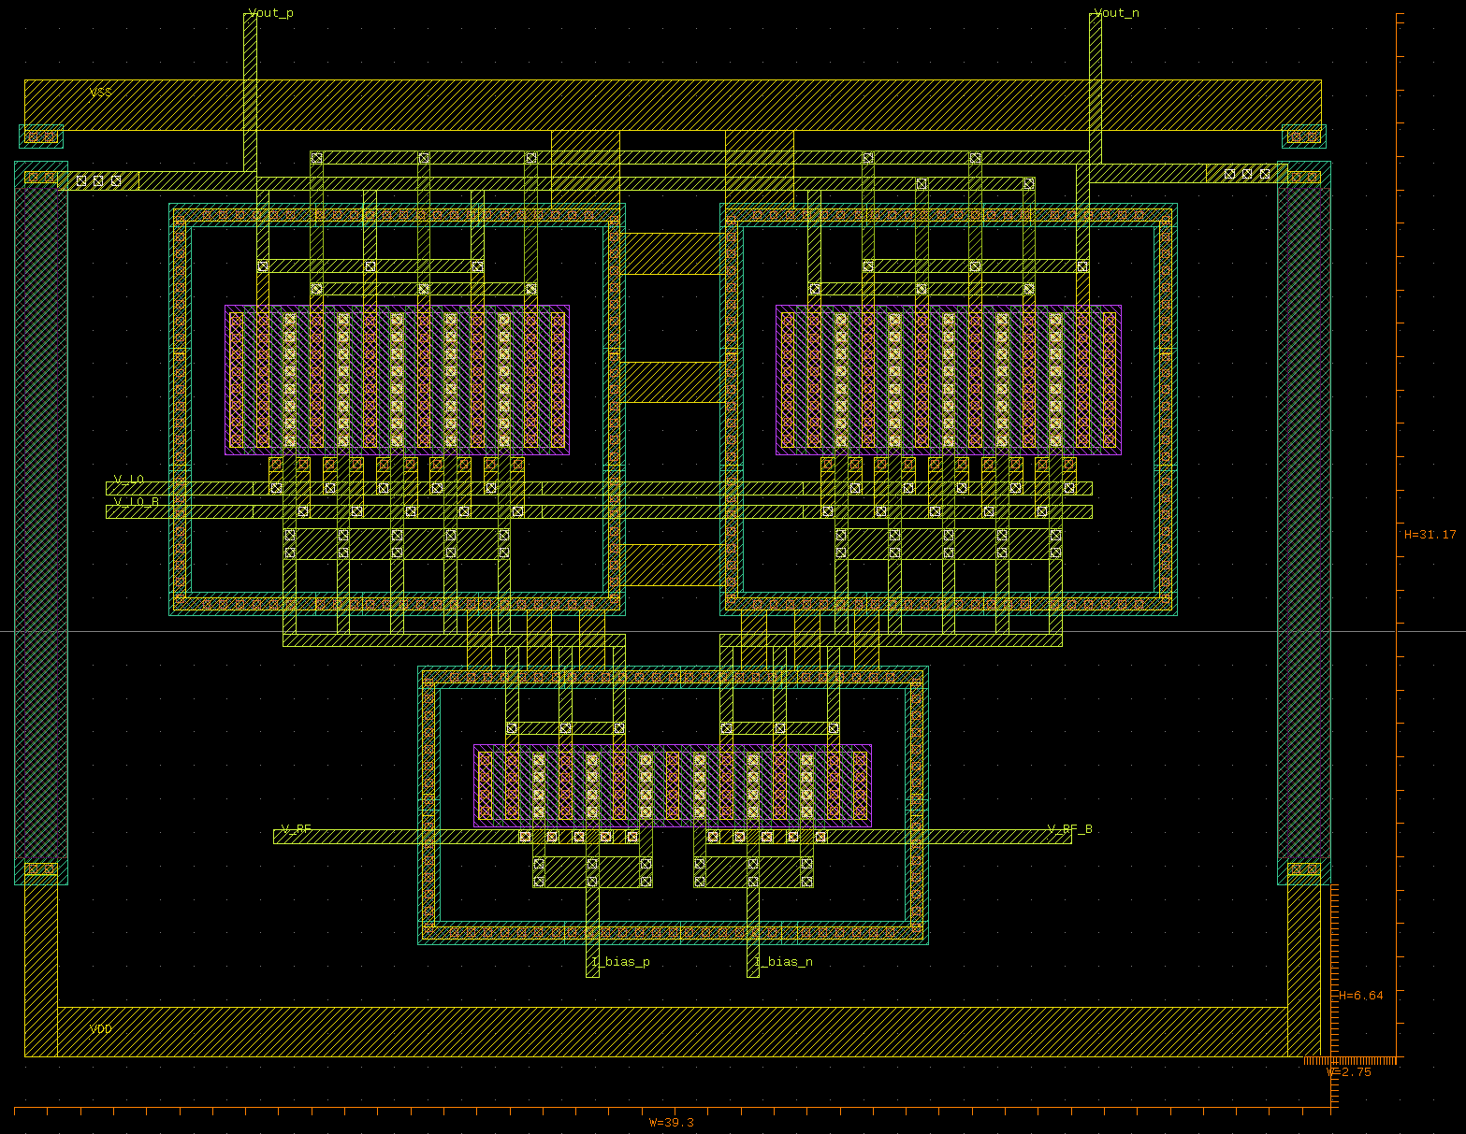
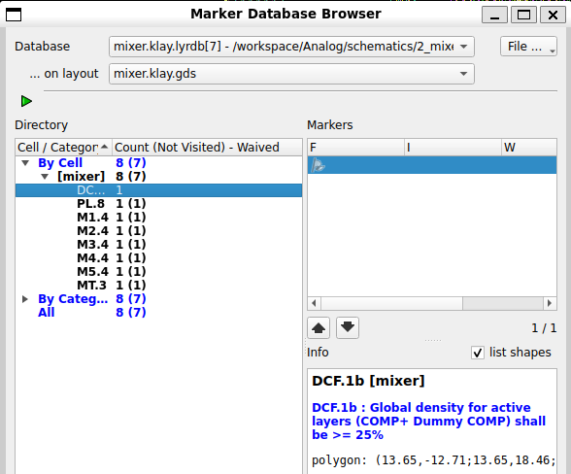
Mixer Layout DRC
Can ignore density rules for all metals and poly and active layers for DRC

Slide 26
Digital - Summary
System Verlog Completed: SPI (100%) State Machine (100%) Wave Controller (100%) Signal Processor (100%)
Cocotb Tested: SPI (90%) State Machine (100%) Wave Controller (100%) Signal Processor (100%)
Gtkwave Timing Visualization: SPI (100%) State Machine (100%) Wave Controller (100%) Signal Processor (100%)
Underdevelopment: Amp Ratio Adjuster
Links: 1. System Verilog HDL Probton\src https://github.com/llhtimlam/Probton/tree/main/src
2. Cocotb Simulation Probton\cocotb https://github.com/llhtimlam/Probton/tree/main/cocotb
3. Gtkwave Probton\cocotb\sim_build
https://github.com/llhtimlam/Probton/tree/main/cocotb/sim_build

Slide 27
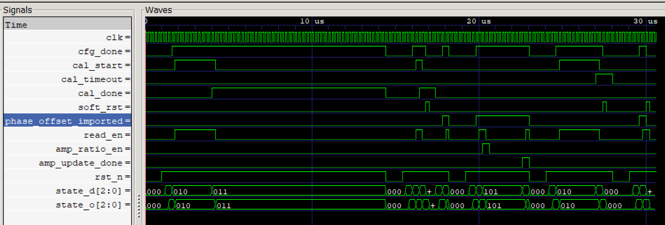
Digital - State Machine Simulation
Boot -> Load Config -> Calibration -> Fallout (cal_done or cal_timeout) Boot -> Load Config -> Readout -> Change Amp Ratio -> Readout Passed test on all transition

Slide 28
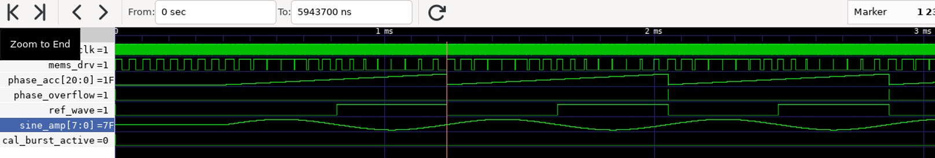
Digital - Wave Controller
Sin wave is generated for memes driver (expecting triangular wave but use sin wave due to third odd harmonic) Square wave is generated for wave mixer reference wave Utilized Sigma Delta Modulator for pwm wave generation

Slide 29
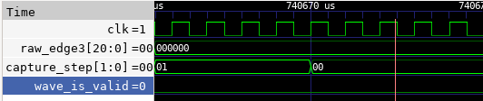
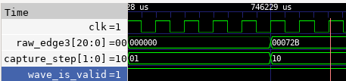
Calibration: Phase-Lag Capture with Jitter Rejection
Jitter guard active
Valid Calibration
Early/invalid edges rejected (wave_is_valid=0)
Capture re-arms, no offset committed
All three edges captured (wave_is_valid=1)
90°/270° offsets computed: ~523k / ~1573k in phase-accumulator units

Slide 30
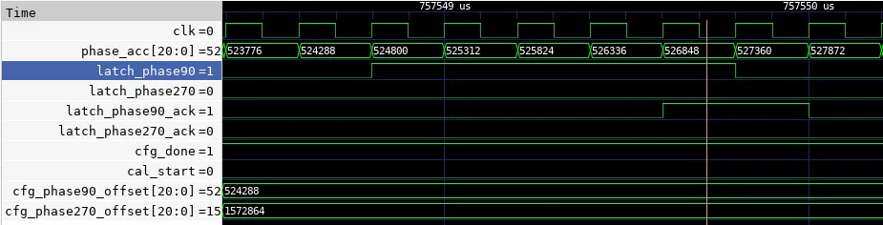
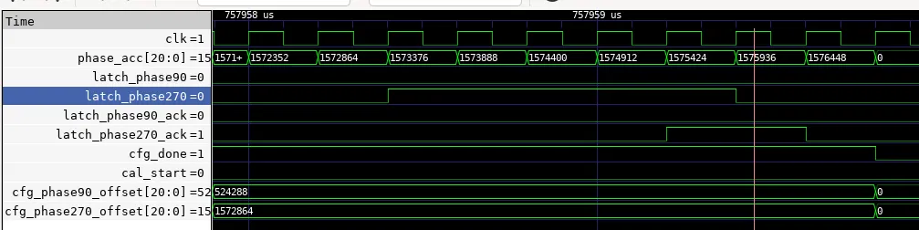
Readout: Phase-Sampling Strobes with Ack Handshake
90° strobe
270° strobe
Fires at phase_acc = 524288 (2²¹/4), held until ack, then cleared
Fires at phase_acc = 1572864 (3·2²¹/4), held until ack, then cleared

Slide 31
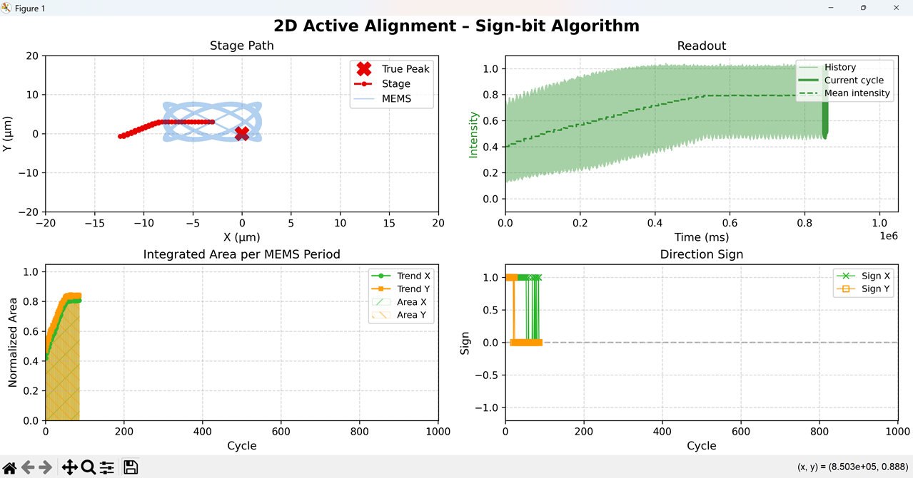
Improvement could be made by voting filter and adjusting amp ratio for better resolution
Simulation Result
Just using the direction bit retrieved from the wave mixer, it is able to locate the center but converge too early.

Slide 32

Improvement could be made by voting filter and adjusting amp ratio for better resolution
Simulation Result
Shows concentrated convergence result due to early converges and not able to identify the direction near peak

Slide 33

Project Planning and Tracker

Slide 34
Question
1. Should we bundle readout intensity with wave mixer error for synchronous digital reporting, or maintain isolated asynchronous paths in analog?
2. How should we change the amp ratio? Should we use a switch to disable the readout and then change the analog setting?
3. Feedback on the chip architect and whole system?
Risk (Looking for advice)
1. Since we decided to skip PLL and use sigma delta modulated for digital wave generation using 8-bit sin LUT, there will be some issue with harmonic. Design solution with eternal RC or alternative wave mixer component that compatible with digital reference wave are considering.
2. Amp Ratio Adjuster might be tricky as it need a lot of wires from digital side for switching resistor feedback.
2. Since we only consider 1 comparator park at 1.65V midrail, it might suffer jittering during idle at 0 offset, which might skew the result from calibration. Hystereis design might be required.

Slide 35
References
[1]. H.-S. Liao *et al.*, "Low-cost, open-source XYZ nanopositioner for high-precision analytical applications," *HardwareX*, vol. 11, p. e00317, 2022. doi: [10.1016/j.ohx.2022.e00317](https://doi.org/10.1016/j.ohx.2022.e00317)
[2]. W.-M. Wang *et al.*, "Low-voltage and high-performance buzzer-scanner based streamlined atomic force microscope system," *Nanotechnology*, vol. 24, no. 45, p. 455503, Nov. 2013. doi: [10.1088/0957-4484/24/45/455503](https://doi.org/10.1088/0957-4484/24/45/455503)
[3]. Rout, Shasanka Sekhar, et al. "Design of 2.4 GHz Improved Current Reuse Gilbert Mixer with Source Degeneration Technique." Wireless Personal Communications, vol. 122, 2022, pp. 3875–3887, https://doi.org/10.1007/s11277-021-09115-6.
[4]. Altuner, Emre, et al. "High-Linearity Gilbert-Cell Mixer Design for Cryogenic Applications." Analog Integrated Circuits and Signal Processing, vol. 113, 2022, pp. 249–256, https://doi.org/10.1007/s10470-022-02098-9.

Slide 36









Team
Tim (Team Lead)
HKUST Chem (UG)
UW HackerFab UWASIC
Abraar TMU CE (UG) LCRAIN
Belkacem UT EE (PhD) Automation Lab
Nitin UCSB EE (PG) Mediatek AMS Design engineer
Reza UCD ECE (PG)
Victoria UW NE (UG)
UWASIC
IQC UG RA
Annika
Kalam HKUST EE (PG)
Ashmita UCD ECE (PG)

